Slide 1
JS Proposals Project
Classifying EcmaScript proposals
Kai Waløen
21 May 2025
Supervised by Mikhail Barash

Slide 2
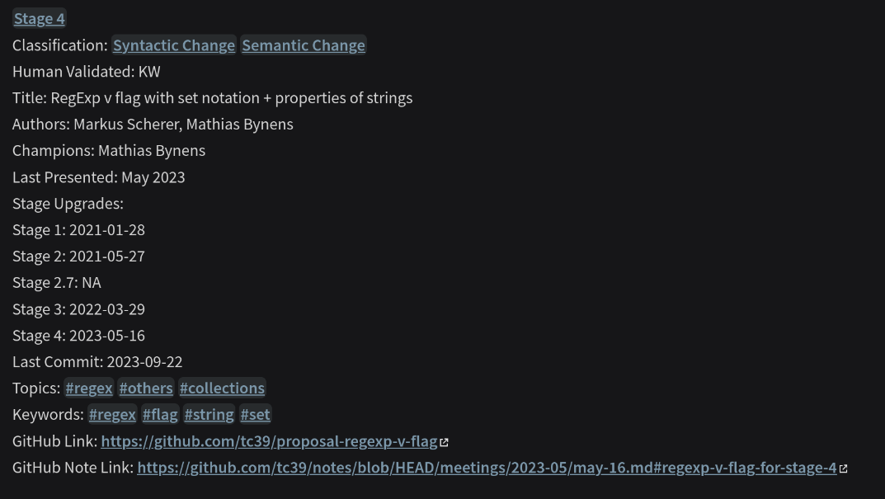
Aims
Collect proposal data
  Snapshot from Feb 2025
  From TC39/proposals repositories
Classify proposals
  Stage
  Type of change
  Topics and keywords
  Present on website
Analyse evolution of proposals
  Pattern in stage bumps?
  Pattern in stage duration?
  Topic dependent?
  Time dependent?
https://js-proposals.vercel.app/

Slide 3
Methods
Data:
  Retrieve data via Github API – TC39/Proposals
  Parse the data, create .md files and saved in Obsidian
  GPT assistance – Classifications, Stage bumps from commit messages, keywords
  Manually verified and curated
  Data analysis done in R and Rstudio
Website:
  Quartz: Open source static page generator with Obsidian compatibilty

Slide 4
Planning
Requirements:
  Present text from proposals
  Proposal details need to be fetchable from Github
  Ability to link and view proposals graph
  Create plots
  Statistical analysis
  Easily and programatically editable text
  Easily (Read: quickly) built website

Slide 5
Right tools for the job
Full stack website?
  React
  Django
  DB
  D3.js
  Cytoscape.js
  Server - nginx
Pros:
  Professional
  Learning
  Exciting
Cons:
  Time consuming
  Skill issues?
Simpler solution?

Slide 6
Chosen tools
Python
  Easy and familiar
  OpenAI API
Obsidian
  .md documents
  Links between md
  Graph
  Free
  Large community
  Static page generators
    Backup Obsidian Publish
    Many open source solutions
Requirements:
  Present text from proposals
  Proposal details need to be fetchable from Github
  Ability to link and view proposals graph
  Create plots
  Statistical analysis
  Easily (Read: quickly) built website
  Easily and programatically editable text
All tools have downsides

Slide 7
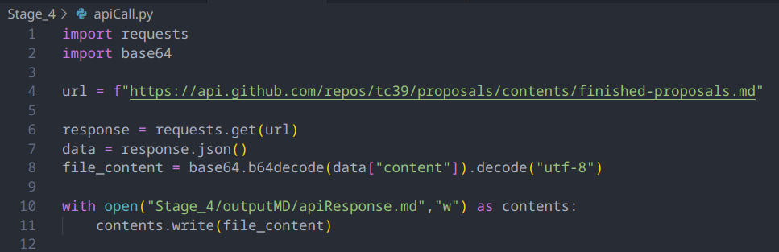
Step 1: Collect Data
“Collect the data and then you can do whatever you want with it”
Web scraper? – Experimented with it but not ideal
Github API – fetch Readme.md
  Well documented
Then I realized that I can just create .md files using Python and open in Obsidian!

Slide 8
Chosen tools
Python
  Easy and familiar
  OpenAI API
Obsidian
  .md documents
  Links between md
  Graph
  Free
  Static page generators
    Backup Obsidian Publish
    Open source Quartz
Requirements:
  Present text from proposals
  Proposal details need to be fetchable from Github
  Ability to link and view proposals graph
  Create plots
  Statistical analysis
  Easily (Read: quickly) built website
  Easily and programatically editable text

Slide 9
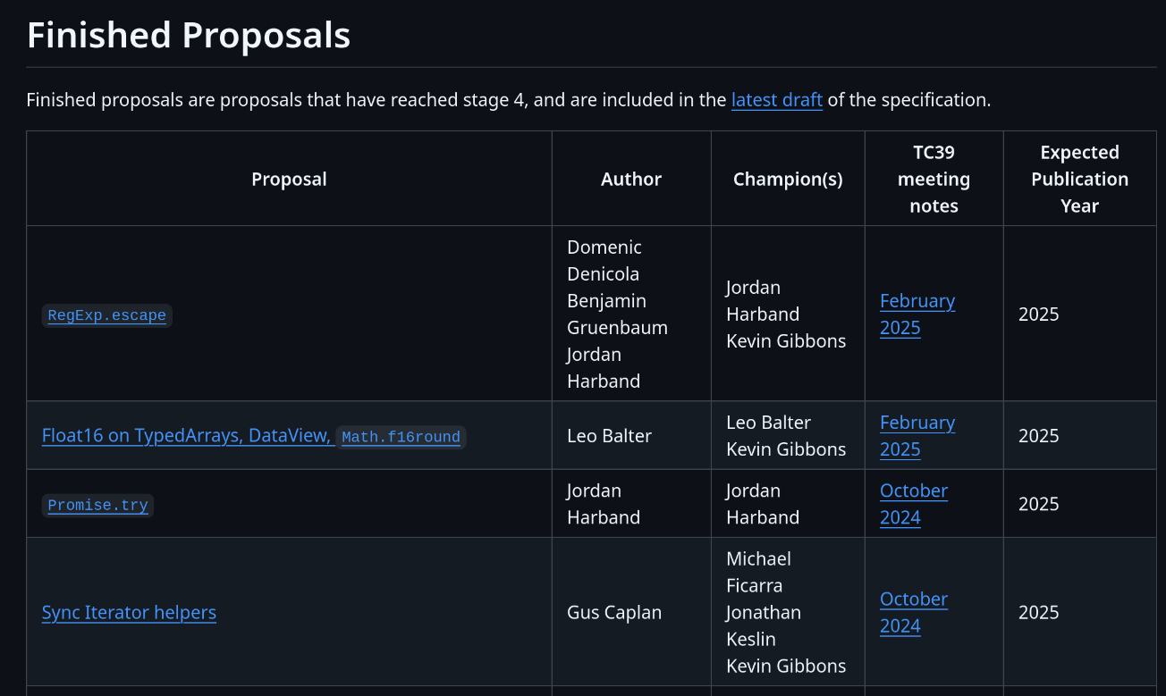
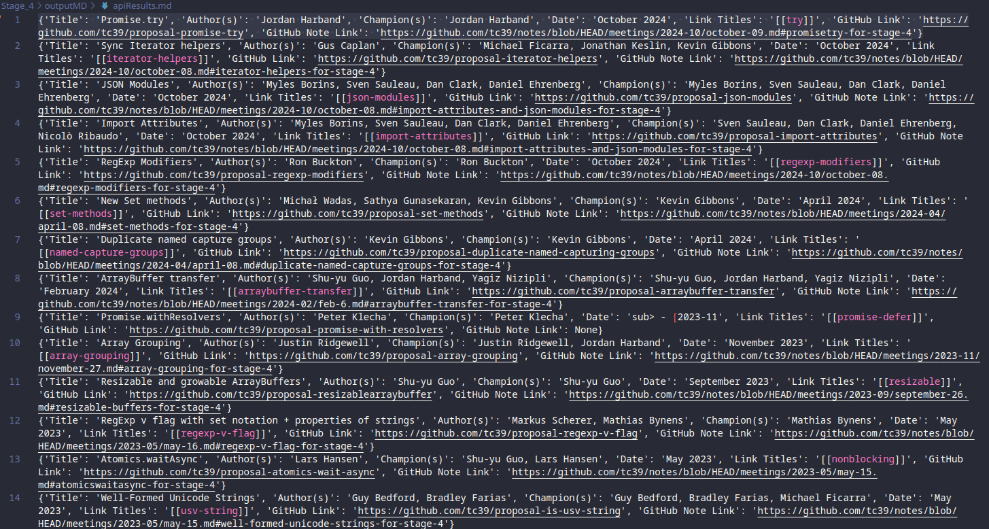
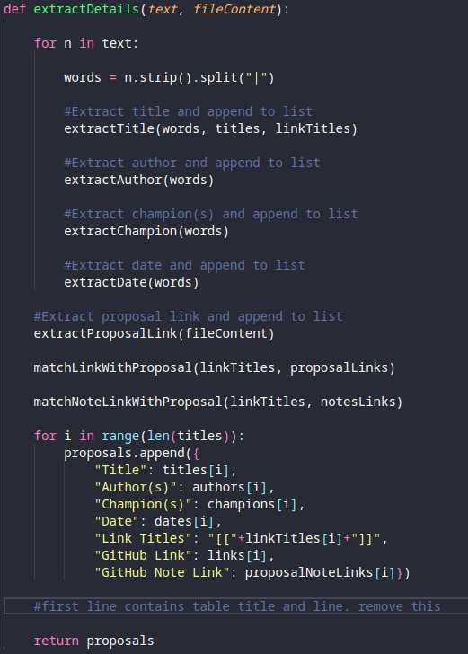
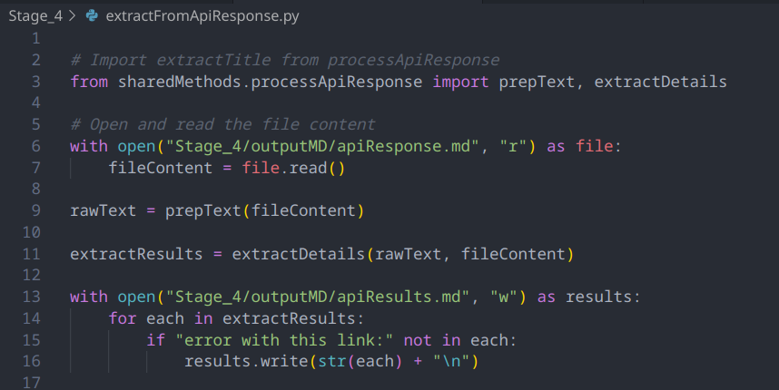
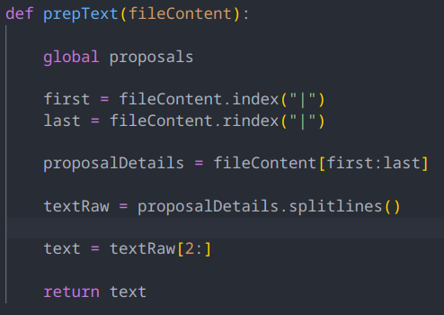
Step 2: Parse API Response
Plan:
  Iterate through apiResponse.md
  Use string methods to extract data
  All data is between “|”

Slide 10
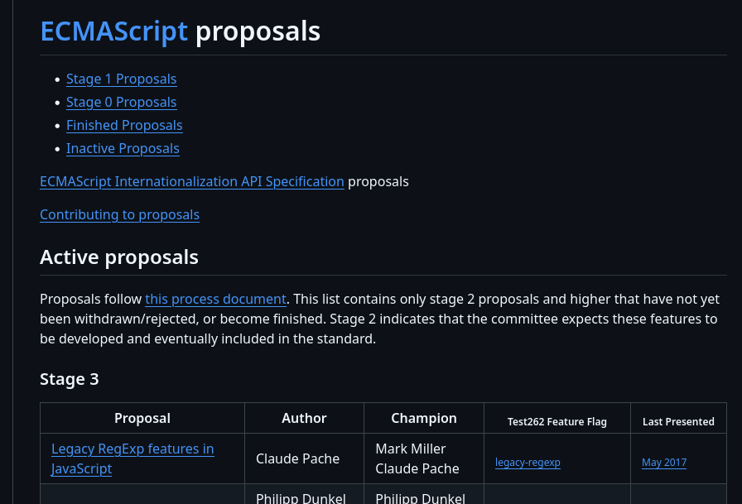
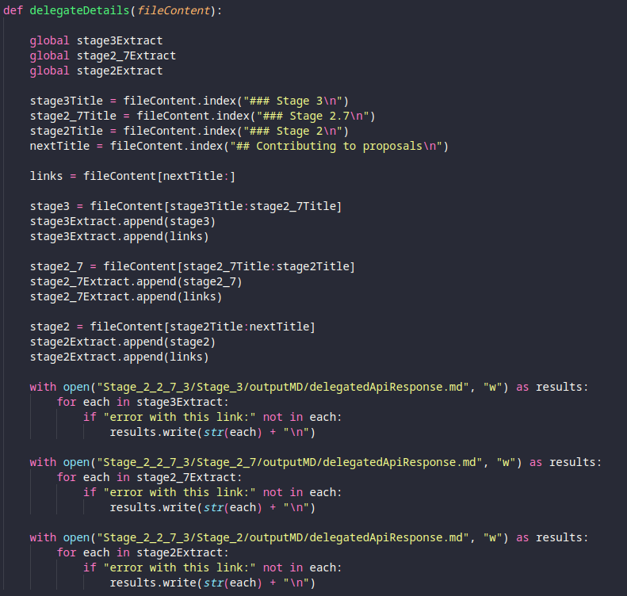
Stage 2, 2.7, and 3
All in same Readme.md
Same structure with extra step
Inconsistencies
Debugging and logging

Slide 11
Status
Able to extract proposal data from Readme.md’s from https://github.com/tc39/proposals for all stages
API response is processed and saved in Stage_X/apiResults.md
  {'Title': 'Promise.try', 'Author(s)': 'Jordan Harband', 'Champion(s)': 'Jordan Harband', 'Date': 'October 2024', 'Link Titles': '[[try]]', 'GitHub Link': 'https://github.com/tc39/proposal-promise-try', 'GitHub Note Link': 'https://github.com/tc39/notes/blob/HEAD/meetings/2024-10/october-09.md#promisetry-for-stage-4'}
Next step is to create md files per proposal in Obsidian

Slide 12
Lessons
Using Github API
Importance of logging to debug
Be careful with Try-catch
Remember Inf101
I don’t know regex
Lots of repeated code

Slide 13
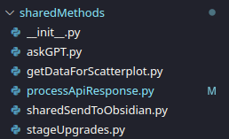
Refactoring
Code is beginning to be unmaintainable
DRY principle
“sharedMethods”
  Refactor code to use shared utility methods
  Import methods

Slide 14
Lessons
Using Github API
Importance of logging to debug
Be careful with Try-catch
String handling practice
Remember Inf101
I don’t know regex
Lots of repeated code
DRY principle

Slide 15
Step 3: Create files in Obsidian
Iterate through and create .md per entry
  Extract fields from apiResults.md
  For each link per stage
    Step 3.1: Extract proposal description
    Step 3.2: Extract last commit date
    Step 3.3: Extract stage bumps
    Step 3.4: Generate 10 keywords
    Step 3.5: Create md document for each proposal

Slide 16
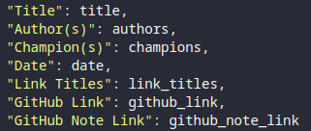
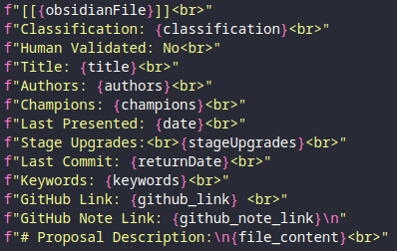
sendToObsidian('Stage 4', 'Stage_4')
For each in Stage_4/outputMD/apiResults.md
If file exists
T
Skip file
Skip file
F
Github API
Extract proposal
description
Extract whole
commit history
Extract latest
commit date
OpenAI API
OpenAI API
OpenAI API
Read proposal description
and classify proposal
Read proposal description
and give 10 keywords
Read commit messages
and find stage bumps

Slide 17
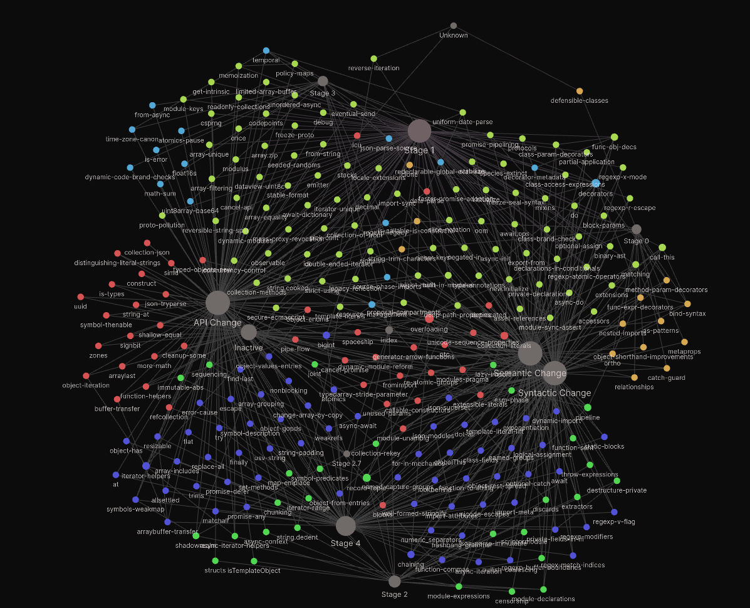
Status
DRY and maintainable code
Successfully collected data
  Classification
  Title
  Authors
  Champions
  Last presented date
  Stage bump dates
  Last Commit date
  Keywords
  Github Link
  Last meeting link
  Project description
Md files that are editable in Obsidian with interactive graph
TODO: ChatGPT assisted but need to verify

Slide 18
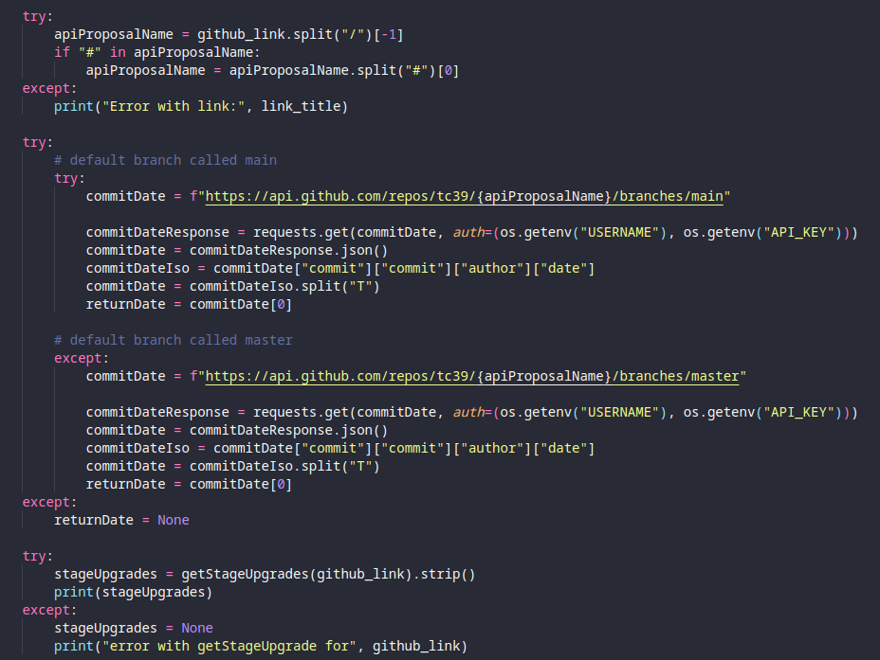
Lessons
Importance of logging
Github API requires auth for > 60 requests per hour
Pagination when to extract commit history
Extracting commit history takes a long time (ca 30 min for 257 proposals)
OpenAI API responses are very fast
Usefulness and danger of try-catch
Frustrating inconsistencies in TC39 repositories
  Main vs master
  README.md vs Readme.md vs readme.md
Terrible commit messages

Slide 19
Step 4: Verify ChatGPT’s work
Including
  Classification
  Stage bump dates
  Keywords
Painstaking manual labor
  ca. 4-5 days to go through everything
  Revised about 5 times

Slide 20
Verifying classifications
systemPrompt = """
I am conducting research on proposals for ECMAScript and have exported proposal descriptions from the GitHub repositories for each proposal.
I am sending you the proposal description and I want you to look at it and classify the type of proposal it is. I want to classify them as API changes, Semantic changes, or Syntactic changes.
### Change Definitions:
- **API Change**: Modifies or introduces new built-in functions, objects, or methods in the standard library. These changes do not affect the syntax of the language but add new functionality to existing features.
- **Semantic Change**: Changes the meaning of the JavaScript code even if the syntax remains the same. These changes can alter the behavior of existing JavaScript programs in subtle or breaking ways. Usually involves modifying execution rules rather than introducing new syntax.
- **Syntactic Change**: Introduces new syntax or modifies existing syntax rules. Usually involves new keywords, operators, or expressions. These changes often require updates to parsers and affect how JavaScript code is written.
### CRITICAL: RESPONSE FORMAT ###
After classifying the proposal, return **ONLY** one of the following strings: - [[API Change]] - [[Semantic Change]] - [[Syntactic Change]] If multiple classifications apply, return a **space-separated string** like:
- [[API Change]] [[Syntactic Change]]
DO NOT return any explanations, markdown, or extra text. Just the classification string.
"""

Slide 21
Verifying classifications
Challenges:
Reading and understanding proposals
  Main purpose?
Reading spec-texts
  Strictly judge based on spec-text?
Overlapping classifications
Lesson:
Proposals and spec-texts are complex
Almost all syntactic changes need to be backed up by semantic change
Most proposals are a combination of synactic/semantic/API change
Open to interpretation
We agreed to focus on the main purpose otherwise all proposals will be syntactic + semantic

Slide 22
Verifying stage bumps
systemPrompt = """
I am conducting research into ECMAScript proposals and I want to look at the timeline of the commits for each proposal. I have extracted the commit history for each proposal and have filtered it down to commit messages, authors, and dates for when the proposal upgraded stage.
I am sending you this data and I want you to take a look at the commit history and return to me a list of when the stage upgrade happened in this format:
Stage 1: *insert date*
Stage 2: *insert date*
Stage 2.7: *insert date*
Stage 3: *insert date*
Stage 4: *insert date*
Since I will be inserting these dates into a md file, please only inlcude the information I have asked for above.
The date for stage 1 should be the earliest commit in the history unless explicitly stated.
If there is no mention of the specific proposal being upgraded, please fill in the date as NA instead. If there is more than one mention of a upgrade for a specific stage, use the earliest date.
Please and thank you in advance!
"""

Slide 23
Verifying stage bumps
Idea: Stage bumps are a big deal so assume they would announce it in commit messages
Turns out, ca. less than half the time especially at lower stages
Went through all commit history
GPT was correct if the stage bump was announced

Slide 24
Verifying keywords
systemPrompt = """
I am conducting research on proposals for ECMAScript and have exported proposal descriptions from the GitHub repositories for each proposal.
I am sending you the proposal description and I want you to look at it and and return to me 10 keywords that are relevant for this proposal.
Please do not include generic, surface level keywords such as "TC39" or "ECMAScript" or "JavaScript".
Please instead include keywords that are directly related to the contents of this proposal.
Please keep the keywords lowercase.
If the proposal is related to a data structure, please include the data structure amongst the keywords.
Please return the keywords in this format with an # in front of the keyword without space: #keyword1 #keyword2 #keyword3 etc...
The correct formatting is CRITICAL. Keep the keywords one word and NEVER EVER use short hand notation. Instead use the full word: for example, use asynchronous instead of async and synchronous instead of sync. If you must to use more than one word per keyword, use an underscore between the words like such: #this_keyword.
CRITICAL: Do NOT, I REPEAT, NEVER include the name OR PART OF THE NAME of the proposal or use the same words as is in the proposal as one of the keywords!
Please and thank you!
"""

Slide 25
Verifying keywords
GPT was not very good at this task
  Didnt follow prompt instructions
  Words were not uniform:
    Eg: “async” vs “Asynchronous” vs “Async”
  GPT used words like “ECMAScript”, “Proposal”, “JavaScript”
Task was to make the keywords uniform as much as possible
Task was to understand proposals at a deeper level and make connections to language constructs

Slide 26
326 Keywords
Rank | Keywords | n
1 | #performance | 32
2 | #iterator | 26
3 | #asynchronous | 22
4 | #promise | 22
5 | #module | 21
6 | #regex | 20
7 | #array | 19
8 | #property | 19
9 | #class | 18
10 | #security | 18
11 | #string | 17
12 | #error_handling | 15
13 | #memory_management | 15
14 | #typedarray | 12
15 | #concurrency | 10
Rank | Keywords | n
16 | #arithmetic | 9
17 | #destructuring | 8
18 | #map | 8
19 | #numeric | 8
20 | #arraybuffer | 7
21 | #decorator | 7
22 | #json | 7
23 | #math | 7
24 | #unicode | 7
25 | #bigint | 6
26 | #generator | 6
27 | #global | 6
28 | #iterable | 6
29 | #key_value_pairs | 6
30 | #parse | 6
Rank | Keywords | n
31 | #realm | 6
32 | #symbol | 6
33 | #date_time | 5
34 | #encapsulation | 5
35 | #grammar | 5
36 | #metadata | 5
37 | #operator | 5
38 | #pattern_matching | 5
39 | #readability | 5
40 | #resource_management | 5
41 | #set | 5
42 | #string_manipulation | 5
43 | #synchronous | 5
44 | #wait | 5
45 | #accessor | 4

Slide 27
Topics
Rank | Topics | Count
1 | #others | 281
2 | #objects | 131
3 | #async | 51
4 | #arrays | 47
5 | #iterators | 45
6 | #modules | 37
7 | #numbers | 36
8 | #performance | 32
9 | #concurrency | 31
10 | #collections | 25
11 | #regex | 25
12 | #security | 23
13 | #memory | 22
14 | #intl | 21
15 | #functions | 12
16 | #types | 11
17 | #realms | 9
18 | #ergonomics | 8
19 | #json | 6
20 | #webassembly | 2
Reduced to 20 Topics from 326 Keywords

Slide 28
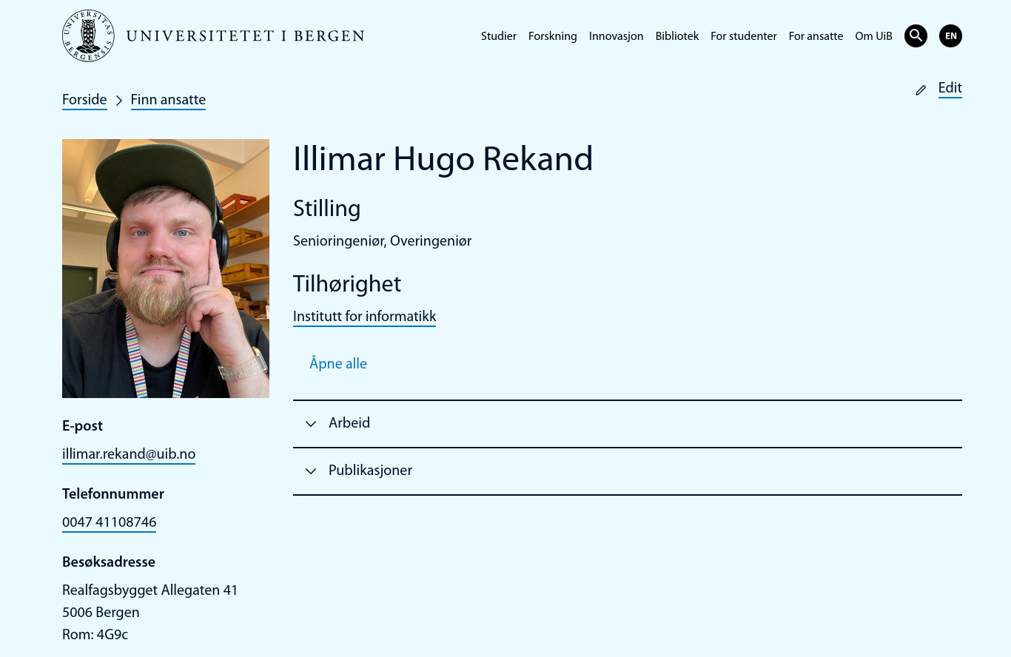
Data Analysis
R and Rstudio
Assistance from Illimar Rekand
  Crash course in R
    Software carpentry
  Advised to use GGPLOT2
    Fantastic documention
https://swcarpentry.github.io/r-novice-gapminder/
https://r-graph-gallery.com/scatterplot.html

Slide 29
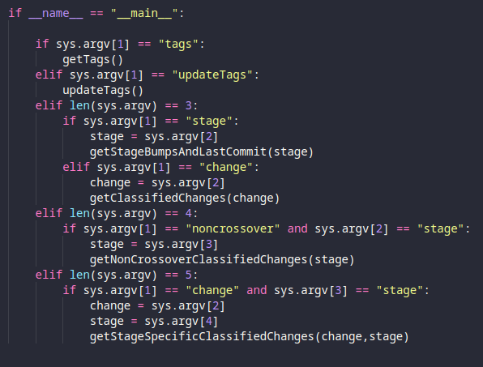
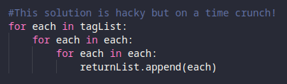
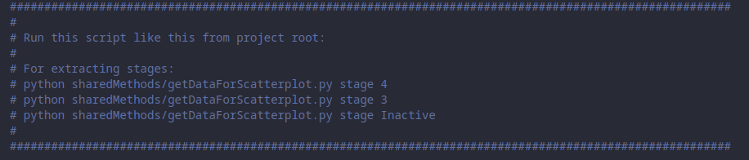
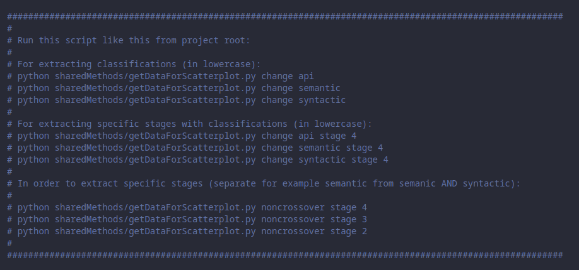
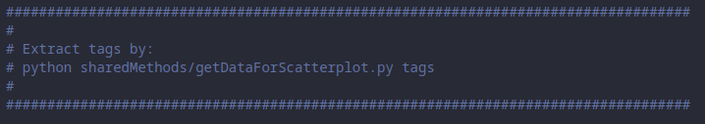
Notes on Data Analysis
Lack of database
Rushed

Slide 30
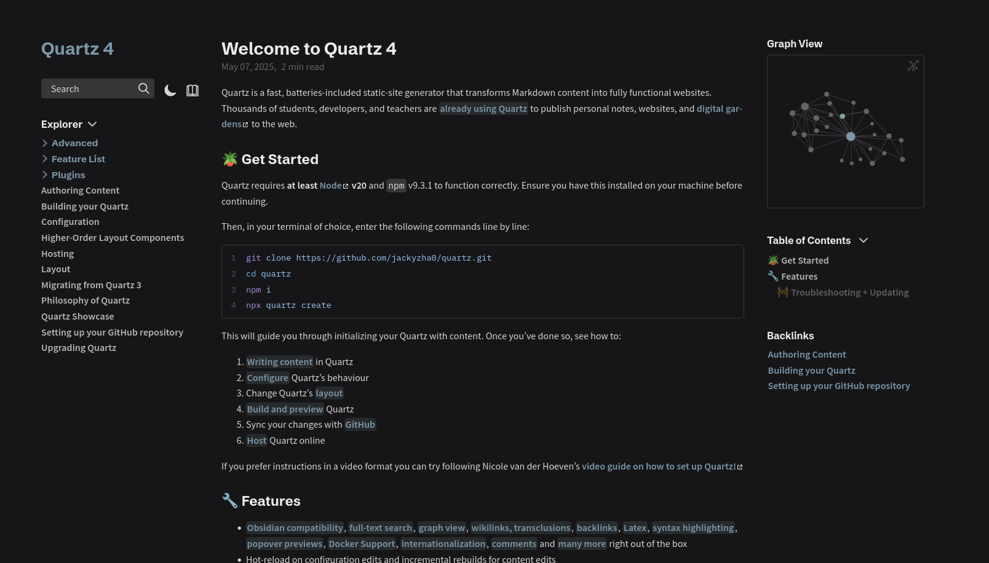
Website
Tried several open source solutions
Decided on Quartz: https://quartz.jzhao.xyz/
Excellent documentation
Hosted on Vercel

Slide 31
My website
Demonstration
https://js-proposals.vercel.app/

Slide 32
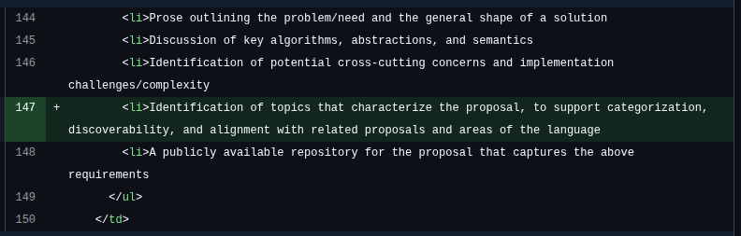
Proposed change to process documents
Presented results to TC39-TG5 on April 30
Proposed change:

Slide 33
My Take Home Lessons
Learnt a lot about JavaScript
  “The more you know, the more you realize you don’t know”
Logging
DRY code
Good commit messages
Good documentation
Limit refactoring
Programming is a muscle

Slide 34
About TC39
Dedicated and competent people
Organized
Cooperative

